Slide 1
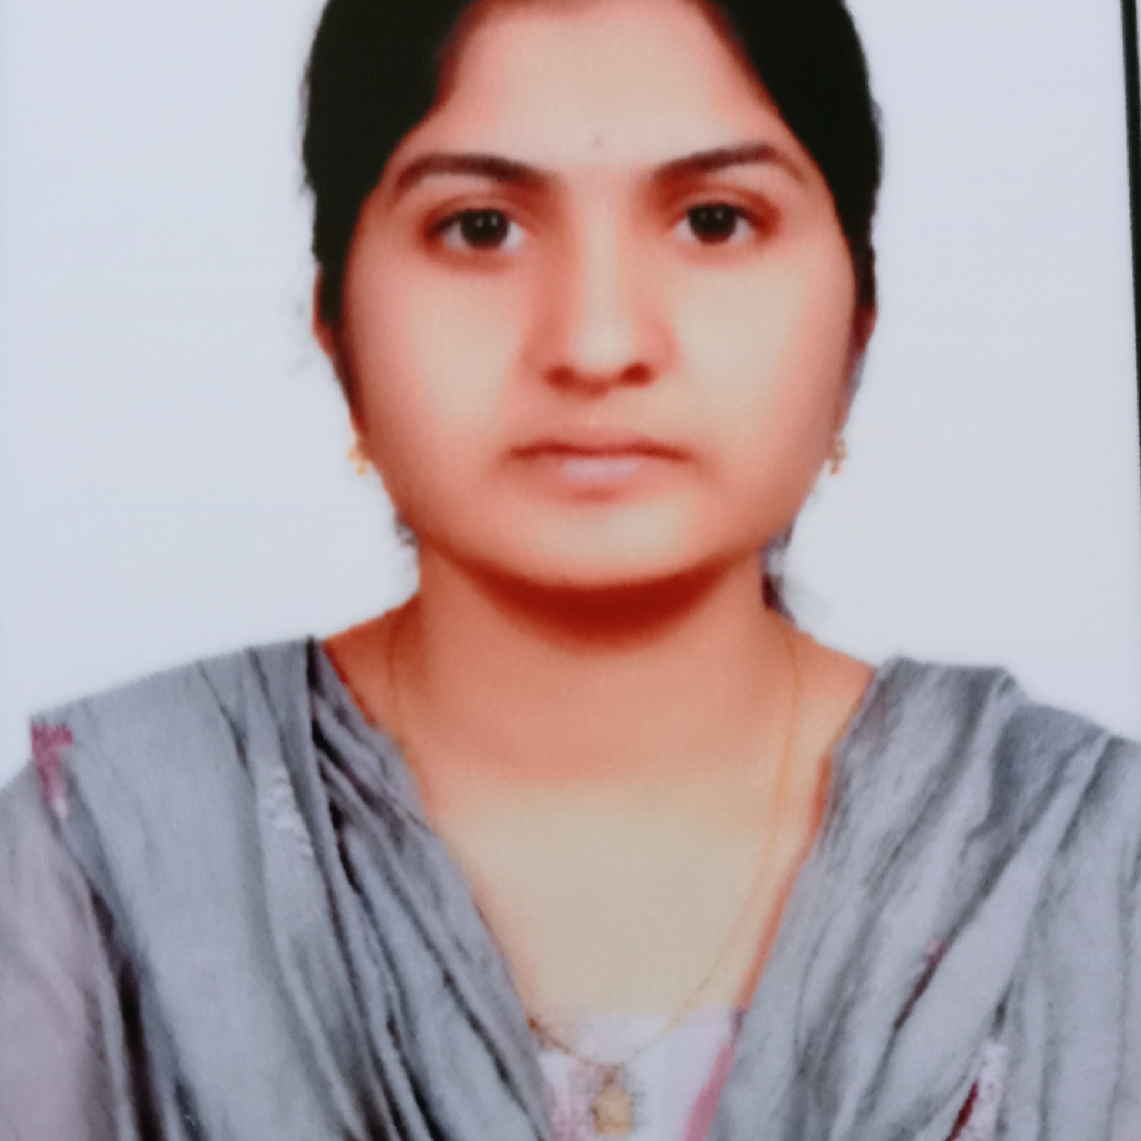


MAYREDDY NIKHITHA
Analyst/Software Engineer
BACHELOR OF TECHNOLOGY
Electronics and communication Engineering:2017-2021
Skills C#
Dot net core
DatabaseL
MS SQL Server 2014
SQL core
Web Technologies
HTML5
CSS3
AddOns
Github
Postman
Additional skills
Leadership Qualities
Quick Learner
Team Management
Good communication
BANGALORE
Nikhitha.may-reddy@capgemini.com
+91 7981810843
A4
Well versed with the functional knowledge of SDLC stages ranging from Requirement Gathering to Analysis, Design, Development, Testing, Deployment and Documentation
Reliable, dedicated and efficient team player and able to adopt the process changes effectively
Ability and flexibility to multi-task, prioritize, and organize multiple projects/ tasks concurrently while meeting project deadlines
Have better understanding on process agility and can come to up to speed on new technologies/ methodologies in best possible way
Able to deliver with zero defects products to customer with good development skills and interact with client with excellent communication skills
Hospital Management System :
Completed end to end case study of Hospital management System along with MVC prototype, web API, Postman, Swagger hub, Bootstrap, CSS used for user interface.
Microsoft Azure Fundementals Certificate :
Completed this course with 72%.
Check out my work on GitHub & Video Profile

